Slide 1
University of Colorado
Colorado Springs
2018 Ethics Survey
Summary Report of Findings
December 3, 2018

Slide 2
Introduction
2018 Employee ECI Ethics Survey: University of Colorado, Colorado Springs
This report summarizes the responses of University of Colorado, Colorado Springs (UCCS) employees in a September 2018 ethics survey conducted by the Ethics & Compliance Initiative (ECI). The purpose of the survey was to:.
  Implement a concise assessment of ethics and compliance in the organization,
  Compare employee perceptions about ethics at UCCS in 2018 to 2017,
  Provide key comparisons with U.S. benchmarks using data from ECI’s 2017 National Business Ethics Survey® (NBES), and
  Identify strengths, opportunities and potential vulnerabilities based on UCCS employee perspectives.
Methodology
The survey was a census survey of all 3,673 UCCS employees (faculty, staff and employed students only). Employees were invited to take the survey online.
Data collection dates: The survey launched September 12, 2018 and closed September 28, 2018.
Response Rates
Overall: There were 691 useable responses, yielding a response rate of 18.8%. Therefore, the UCCS data have a confidence interval (margin of error) of +/- 3.4 percent at the 95% confidence level.¹ For example, if 50% answered Yes to a particular question, we are 95% confident that the actual value is no higher than 53.4% or lower than 46.6%.
1 The confidence interval has been generated using Custom Insight's survey calculator: http://www.custominsight.com/articles/random-sample-calculator.asp

Slide 3
Response Rates
Response Rates by Employee Groups
Note: The margin of error (confidence interval) has been generated using Custom Insight's survey calculator: http://www.custominsight.com/articles/random-sample-calculator.asp

Slide 4
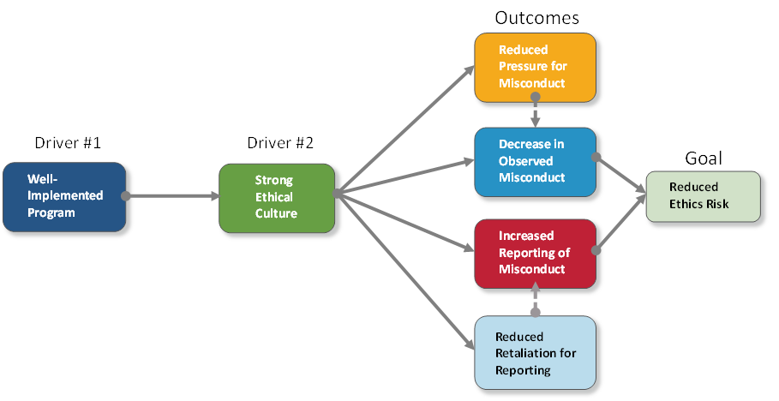
The ECI Analysis Framework
The ECI Ethics Survey measures pivotal elements of ECI’s model of analysis (shown below). Metrics for ethics and compliance (E&C) program effectiveness are presented first, followed by data that provide insight into the strength of the organization’s ethical culture, and concluding with results that provide indications of the level of ethics risk within the organization. Analysis is conducted comparing overall organization results against NBES® averages. This model utilizes concepts expressed in the Federal Sentencing Guidelines for Organizations (FSGO) (amended 2014). The FSGO provide significant incentives for organizations to design, implement, and enforce an effective ethics and compliance program. The FSGO also emphasize the importance of using due diligence to “promote an organizational culture that encourages ethical conduct and a commitment to compliance with the law.”³ The specific metrics are described more thoroughly on the next page.
Causal:
Correlational:
³ United States Sentencing Commission Guidelines Manual, USSG §8B2.1(a)(2) (2014)

Slide 5
Primary Areas of Focus
1|PROGRAMS: Well-implemented ethics programs lead to stronger cultures and improved ethics outcomes
A well-implemented E&C program is comprised of key resources that inform employees and prepare them for ethics-related issues that they may encounter in their workplace. Effective resources are practical, valuable, and useful to employees as they make ethics related decisions. The better the quality of an E&C program, the more embedded E&C is within the organizational culture. A stronger ethics culture ultimately improves desirable ethics outcomes such as reduced pressure for employees to compromise standards.
2|CULTURE: A strong ethics culture is key to achieving desired ethics outcomes
The strength of an organization’s ethics culture is measured through multiple indicators of the behavior of employees at various levels throughout an organization. These behaviors exhibit the enterprise-wide approach to ethics culture by the organization and demonstrate and promote a commitment to ethics on a daily basis. A strong ethics culture involves commitment, modeling, and right conduct by: leaders, supervisors, and all employees.
3|OUTCOMES: Ethics outcomes are measured by employee perspectives, actions and behaviors
Effective programs and strong ethical cultures improve ethics outcomes – measurable, manageable actions undertaken by employees. The four, major, desired ethics outcomes measured by ECI are:
  DECREASED PRESSURE for employees to violate ethics standards;
  DECREASED OBSERVED MISCONDUCT amongst employees;
  INCREASED REPORTING of observed misconduct by employees; and
  DECREASED RETALIATION experienced by employees for reporting misconduct.

Slide 6


Summary of Results – UCCS Overall
Strengths
Opportunities
E&C Program: Compared with 2017, UCCS employees trend* more likely to feel that they can raise concerns to management (55% vs. 51%).
Ethics Culture: Compared with 2017, UCCS employees are, or trend, more likely to perceive the ethical conduct of top management, supervisors, and their coworkers. For example, in 2018, more UCCS employees perceive that top management talks about the importance of workplace ethics compared with 2017 (76% vs. 69%).
Key Ethics Outcomes: Compared with 2017, UCCS employees are less likely to feel pressure to compromise standards (9% vs. 14%) and trend less likely to observe misconduct (23% vs. 26%).
E&C Program: Compared with the NBES, UCCS employees are less likely to believe that they can raise concerns to management (55% vs.64%).
Ethics Culture: Compared with the NBES, UCCS employees trend less likely to perceive that top management sets a good example of ethical workplace conduct (72% vs. 75%).
Key Ethics Outcomes: Compared with 2017, UCCS employees trend less likely to report their observations of misconduct (61% vs. 64%) and trend more likely to perceive retaliation for reporting (37% vs. 29%).
* Throughout this report, when the term “trend” is used it indicates differences that are not different by a statistically significant margin. Otherwise, differences are statistically different.

Slide 7
Summary of Results – UCCS Overall
In 2018, Most Areas Are, or Trend, More Favorable Compared with 2017
The asterisk indicates a trend difference between UCCS 2018 and 2017 results. When the term “trend” is used it indicates differences that are not different by a statistically significant margin. Otherwise, differences are statistically different.
UCCS (2017) 2018 ‘n’ sizes: Can Raise Concerns = (346) 639; Evaluation of Ethical Conduct = (372) 691; Top Management Talks = (348) 652; Top Management Sets Example = (348) 642; Supervisor Supports Employee = (358) 673; Supervisor Held Accountable = (337) 634; Pressure = (356) 667; Misconduct = (334) 638;
Reporting = (87) 143; Retaliation = (44) 69

Slide 8
Program Outcomes and Benchmarks Summary
A Well-Implemented Ethics Program
A well implemented ethics & compliance program is comprised of several elements including:
A code of conduct
Training on the code,
A reporting and/or ethics advice line,
A system to discipline those who commit misconduct, and
Evaluation of ethical conduct in performance evaluations.
To be well-implemented, a program also needs to be effective. Signs of effectiveness include:
Employees feeling able to raise concerns,
Employees seeking advice in uncertain ethics situations,
Positive feedback from their supervisor about ethics,
Employees feeling prepared to handle uncertain ethics situations,
Rewards for ethical conduct, and
Awareness that questionable means are not rewarded.
In UCCS, employees were asked about the two most impactful program metrics: Raising concerns and Evaluation.
In 2018, the percentage of UCCS employees who feel that they can raise concerns to management (55 percent) trends higher compared with 2017 (51 percent), but is below the NBES benchmark (64 percent).
Compared with 2017, in 2018 UCCS employees are more likely to agree that the organization evaluates employees on their ethical conduct as part of performance evaluations (38 percent versus 31 percent). However, this is less than the NBES benchmark (64 percent).
Can Raise Concerns UCCS 2017 n = 346; UCCS 2018 n = 639; NBES 2017 n = 5,007
Evaluation UCCS 2017 n = 372; UCCS 2018 n = 691; NBES 2017 n = 5,124

Slide 9
Ethics Culture: Top Management Benchmarks and Summary
The Importance of Ethical Leadership
Employees look to leadership to set the tone at the top through both their words and their actions.
A clear message that ethical behavior is expected helps to increase reporting of misconduct and contributes substantially to perceptions about a strong ethical culture. Positive impacts are also seen in lower levels of pressure, misconduct, and retaliation.
Note: Survey participants were provided the following definition to use when answering questions about
Top Management:
Chancellor, Vice Chancellors, Assistant and Associate Vice Chancellors, Executive Directors, Directors, Deans and Associate Deans
In 2018, UCCS employees are more likely to agree that top management talks about the importance of workplace ethics as compared with 2017 (76 percent vs. 69 percent).
Compared with 2017, in 2018 employees are as likely to agree that their direct supervisor sets a good example of ethical workplace conduct (72 percent vs. 70 percent). This is also comparable with the NBES benchmark (75 percent).
Top Management Talks UCCS 2017 n = 348; UCCS 2018 n = 652; NBES 2017 n = 5,033
Top Management Sets Example UCCS 2017 n = 348; UCCS 2018 n = 642; NBES 2017 n = 5,035

Slide 10
Ethics Culture: Direct Supervisor Benchmarks and Summary
The Importance of Supervisor Reinforcement of Ethics
Supervisors play critical roles in forming the ethical culture in an organization.
Relative to top management and coworkers, supervisors are most strongly associated with a reduction in pressure to compromise organization ethics standards. Supervisor support is found to be most critically associated with a reduction in pressure to violate ethics standards.
Supervisors can be substantial agents in reducing ethics risk. ECI research shows that 4 out of 5 employees report observations of misconduct to them.
In 2018, the percentage of UCCS employees who feel that their direct supervisor talks about the importance of workplace ethics (74 percent) is comparable with the NBES benchmark (74 percent).
Compared with the NBES benchmark (80 percent), in 2018 UCCS employees are as likely to agree that their supervisor sets a good example of ethical workplace conduct (82 percent).
Compared with the NBES (80 percent), employees in UCCS in 2018 are more likely to agree that their direct supervisor supports them in following the code of conduct (86 percent).
In 2018, UCCS employees are more likely than in 2017 to believe that their supervisor would be held accountable for a potential violation of the code of conduct (82 percent versus 76 percent).
Note: n/a – In 2017, questions about supervisors talking about ethics and setting a good example of workplace ethics were not asked.
Supervisor Talks UCCS 2018 n = 683; NBES 2017 n = 4,922
Supervisor Sets Example UCCS 2018 n = 675; NBES 2017 n = 4,926
Supervisor Supports Employees UCCS 2017 n = 358; UCCS 2018 n = 673; NBES 2017 n = 4,898
Supervisor Held Accountable UCCS 2017 n = 337; UCCS 2018 n = 634; NBES 2017 n = 4,832

Slide 11
Coworkers/Peers: Talk about the Importance of Workplace Ethics
The Importance of Coworker Commitment to Ethics
Coworkers create the context in which employees frame their decisions and actions.
They can provide a safe work environment that helps to bring out ethical conduct in others. In a toxic coworker culture, employees are less likely to raise concerns for fear of reprisal.
Fair and equal treatment of employees by supervisors help to create cohesive coworker cultures.
Note: In 2017, a question about coworkers/peers talking about the importance of ethics was not asked in the UCCS or the NBES survey.
UCCS 2018 n = 682 (Staff n = 364; Faculty n = 110; Students n = 211)

Slide 12
Ethics Outcomes and Benchmarks Summary
Pressure
The predominant forms of pressure are meeting performance targets, supervisory pressure, and saving one’s job.
Misconduct
Misconduct is primarily interpersonal – such as abusive behavior. Analysis of it can reveal whether the organization contains a few bad apples, or is a bad tree.
Reporting
Organizations that lack knowledge about the events taking place within are left only with an ability to react to crises and not an ability to avoid them.
Retaliation
Retaliation dampens future reporting. Whether perception or reality, an organization must still resolve employees’ reports of retaliation.
The percentage of UCCS employees feeling pressure to compromise standards of ethical conduct (nine percent) is less than the NBES (16 percent).
The percentage observing misconduct is less than that in the NBES (23 percent versus 28 percent).
Compared to the NBES, the reporting rate at UCCS trends less favorable, 61 percent versus 69 percent.
Of those who reported misconduct, 37 percent said they experienced retaliation for doing so, trending higher than in 2017, but trending lower than the 44 percent in the NBES.
Pressure UCCS 2017 n = 356; UCCS 2018 n = 667; NBES 2017 n = 5,032
Observed Misconduct UCCS 2017 n = 334; UCCS 2018 n = 638; NBES 2017 n = 4,974
Reported Misconduct UCCS 2017 n = 87; UCCS 2018 n = 143; NBES 2017 n = 1,352
Perceived Retaliation UCCS 2017 n = 44; UCCS 2018 n = 69; NBES 2017 n = 902

Slide 13
2650 Park Tower Drive, Suite 802
Vienna, Va. 22180
Phone 703-647-2185 research@ethics.org
www.ethics.org

